Slide 1

Chapter 7 Evaluating, comparing, and expanding models
林思涵
2020/11/24

Slide 2
Outline
Measures of predictive accuracy
Information criteria and cross-validation
Model comparison based on predictive performance
Model comparison using Bayes factors
Continuous model expansion

Slide 3
Measures of predictive accuracy

Slide 4

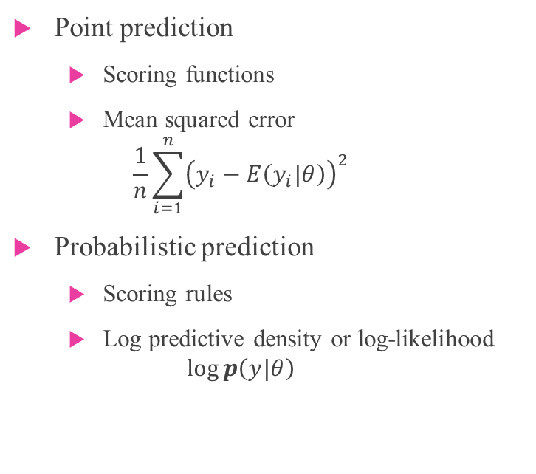
Measures of predictive accuracy
Point prediction
Scoring functions
Mean squared error
$$\frac{1}{n}\sum_{i=1}^{n}{{\left(y_{i}−E\left(y_{i}|θ\right)\right)}^{2}}$$
Probabilistic prediction
Scoring rules
Log predictive density or log-likelihood
$$\log{p\left(y|θ\right)}$$
$f$：true model
$y：$observed data
$\tilde{y}$：future data
We are interested here in summarizing
the fit of model to data.

Slide 5
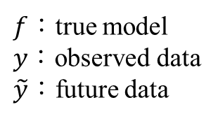
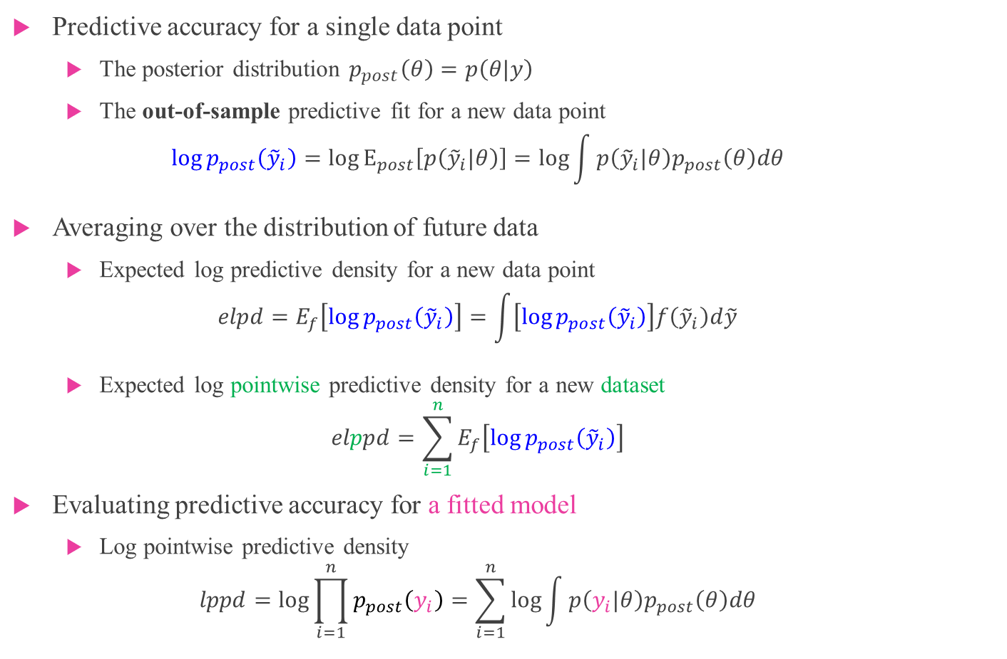
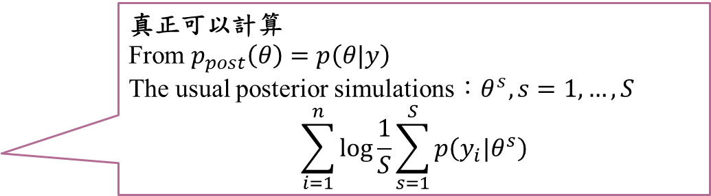
Measures of predictive accuracy
$f$：true model
$y：$observed data
$\tilde{y}$：future data
Predictive accuracy for a single data point
The posterior distribution $p_{post}\left(θ\right)=p\left(θ|y\right)$
The out-of-sample predictive fit for a new data point
$$\log{p_{post}\left({\tilde{y}}_{i}\right)}=\log{E_{post}\left[p\left({\tilde{y}}_{i}|θ\right)\right]}=\log{\int{p\left({\tilde{y}}_{i}|θ\right)p_{post}\left(θ\right)dθ}}$$
Averaging over the distribution of future data
Expected log predictive density for a new data point
$$elpd=E_{f}\left[\log{p_{post}\left({\tilde{y}}_{i}\right)}\right]=\int{\left[\log{p_{post}\left({\tilde{y}}_{i}\right)}\right]f\left({\tilde{y}}_{i}\right)d\tilde{y}}$$
Expected log pointwise predictive density for a new dataset
$$elppd=\sum_{i=1}^{n}{E_{f}\left[\log{p_{post}\left({\tilde{y}}_{i}\right)}\right]}$$
Evaluating predictive accuracy for a fitted model
Log pointwise predictive density
$$lppd=\log{\prod_{i=1}^{n}{p_{post}\left(y_{i}\right)}}=\sum_{i=1}^{n}{\log{\int{p\left(y_{i}|θ\right)p_{post}\left(θ\right)dθ}}}$$
真正可以計算
From $p_{post}\left(θ\right)=p\left(θ|y\right)$
The usual posterior simulations：$θ^{s}, s=1,…,S$
$$\sum_{i=1}^{n}{\log{\frac{1}{S}\sum_{s=1}^{S}{p\left(y_{i}|θ^{s}\right)}}}$$

Slide 6


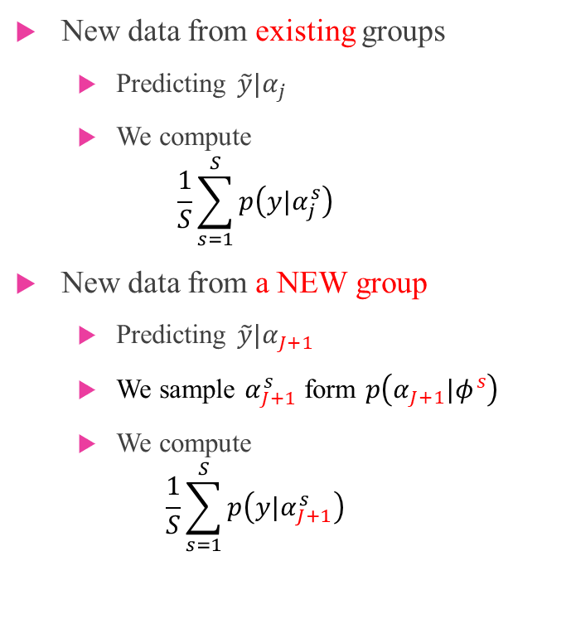



Measures of predictive accuracy Choices in defining the likelihood and predictive quantities
Hierarchical model
New data from existing groups
Predicting $\tilde{y}|α_{j}$
We compute
$$\frac{1}{S}\sum_{s=1}^{S}{p\left(y|α_{j}^{s}\right)}$$
New data from a NEW group
Predicting $\tilde{y}|α_{J+1}$
We sample $α_{J+1}^{s}$ form $p\left(α_{J+1}|φ^{s}\right)$
We compute
$$\frac{1}{S}\sum_{s=1}^{S}{p\left(y|α_{J+1}^{s}\right)}$$
$$φ$$
$$α_{1}$$
$$α_{2}$$
$$⋯$$
$$α_{J}$$

Slide 7
Information criteria and cross-validation

Slide 8
Information criteria and cross-validation
Estimating out-of-sample predictive accuracy using available data
Within-sample predictive accuracy
A naive estimate of the expected log predictive density for new data is the log predictive density for existing data.
Adjusted within-sample predictive accuracy
AIC, Akaike information criterion
DIC, Deviance information criterion
WAIC, Watanabe-Akaike or widely applicable information criterion
BIC, ‘Bayesian’ information criterion
Cross-validation, Leave-one-out cross-validation ( LOO-CV)
Overestimate !!

Slide 9
Example: Forecasting presidential elections
Bread and Peace

Slide 10
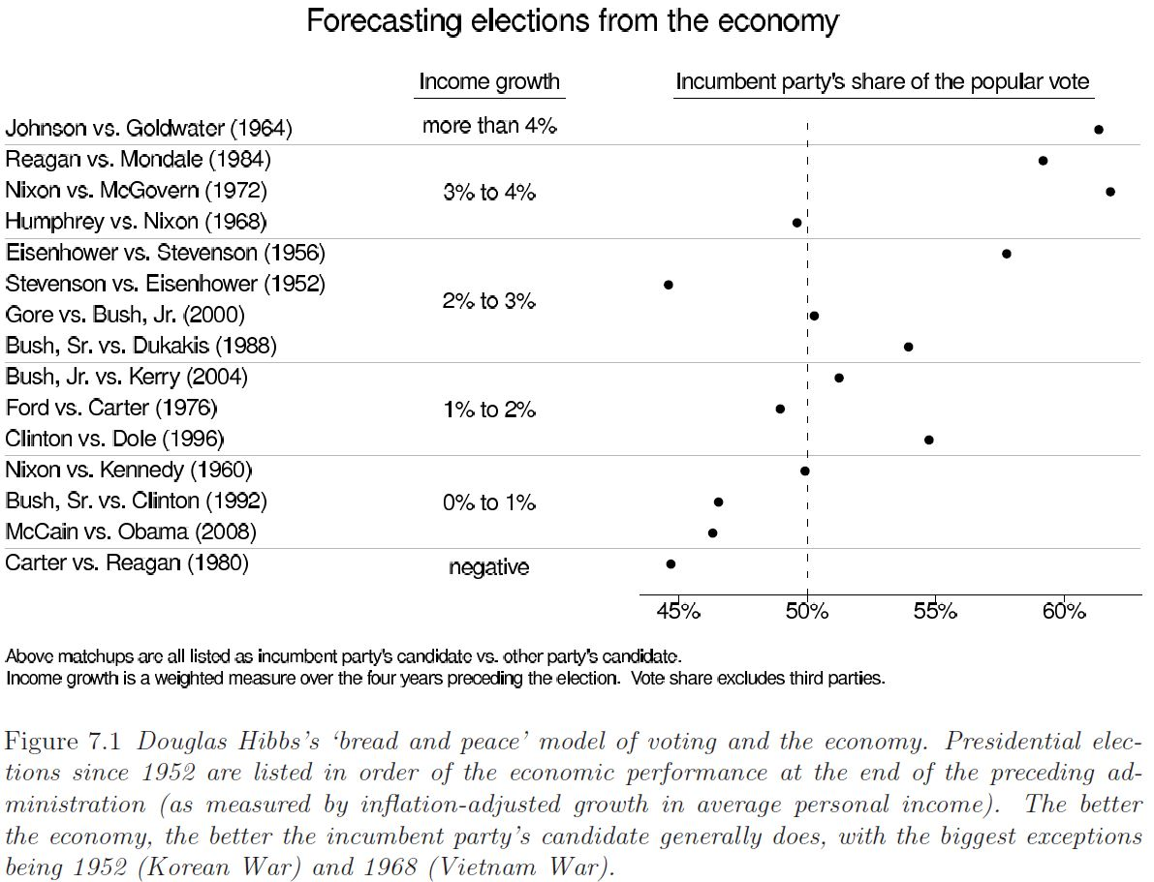

x
y
越南戰爭
朝鮮戰爭
$$y\sim N\left(a+bx,σ^{2}\right)$$

Slide 11
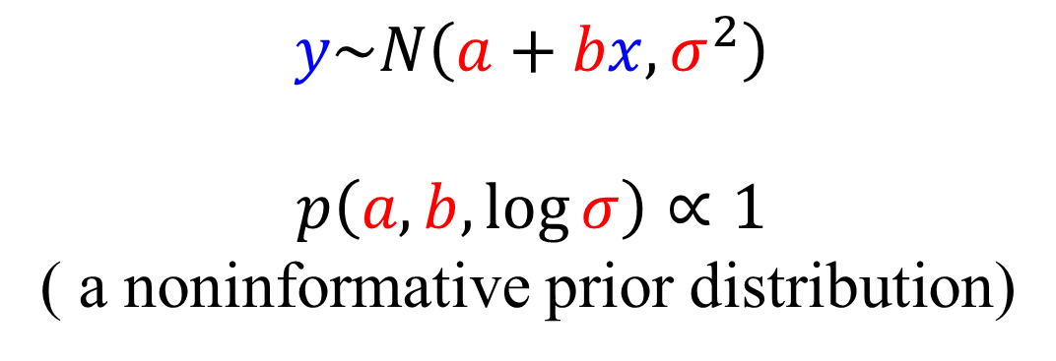
Forecasting presidential elections
$$y\sim N\left(a+bx,σ^{2}\right)$$
$$p\left(a,b,\log{σ}\right)∝1$$
( a noninformative prior distribution)

Slide 12
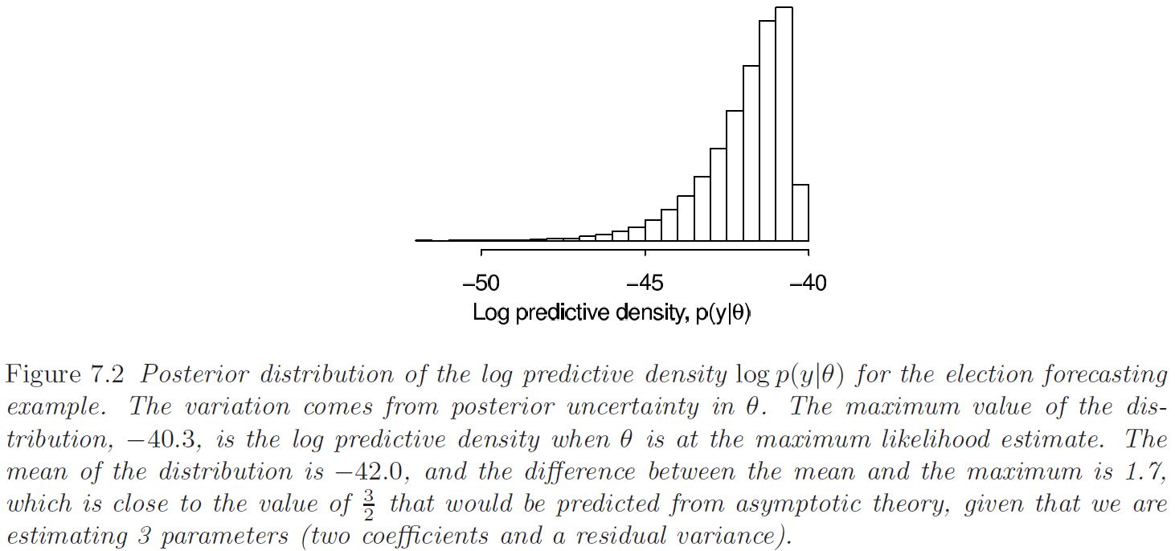

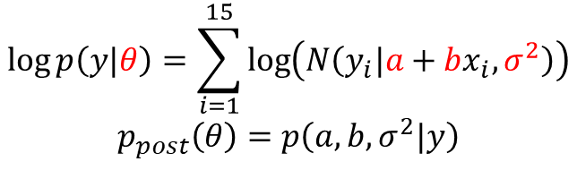
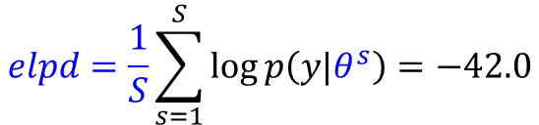





Information criteria (校正原因) Fit of the election forecasting model: Bayesian inference
$${\hat{θ}}_{MLE}$$
$θ^{s}$, $s=1,⋯,10,000$
$$\log{p\left(y|θ\right)}=\sum_{i=1}^{15}{\log\left(N\left(y_{i}|a+bx_{i},σ^{2}\right)\right)}$$
$$p_{post}\left(θ\right)=p\left(a,b,σ^{2}|y\right)$$
$$\sim χ_{k=3}^{2}$$
$$elpd=\frac{1}{S}\sum_{s=1}^{S}{\log{p\left(y|θ^{s}\right)}}=−42.0$$
$$elpd=\log{p\left(y|{\hat{θ}}_{MLE}\right)−\frac{k}{2}}$$
$$\log{p\left(y|{\hat{θ}}_{MLE}\right)}=−40.3$$
$$\sim \frac{k}{2}=\frac{3}{2}$$

Slide 13
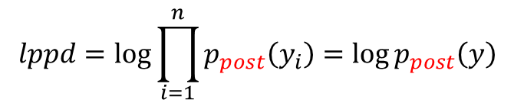
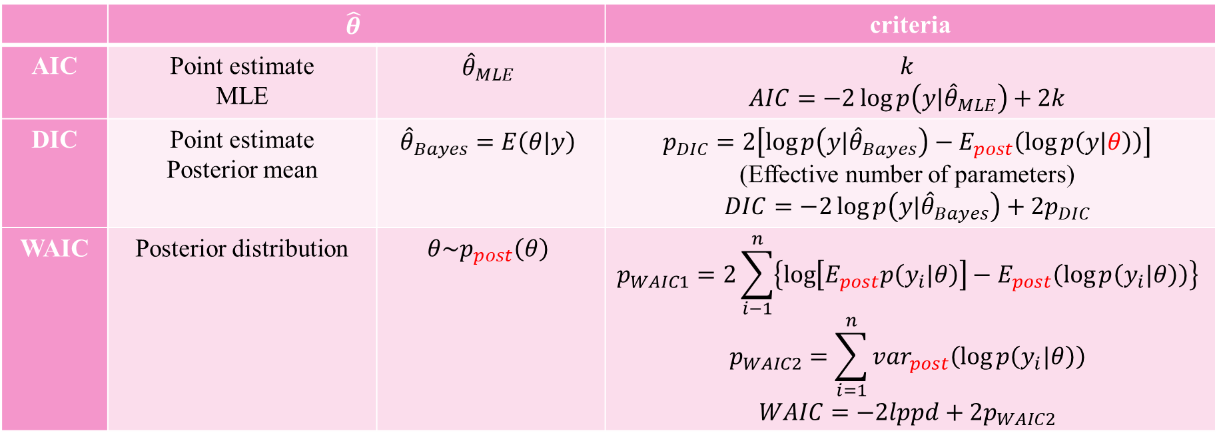

Information criteria Adjusted within-sample predictive accuracy
 | $$\hat{θ}$$ |  | criteria
AIC | Point estimate MLE | $${\hat{θ}}_{MLE}$$ | $$k$$ $$AIC=−2\log{p\left(y|{\hat{θ}}_{MLE}\right)}+2k$$
DIC | Point estimate Posterior mean | $${\hat{θ}}_{Bayes}=E\left(θ|y\right)$$ | $$p_{DIC}=2\left[\log{p\left(y|{\hat{θ}}_{Bayes}\right)−E_{post}\left(\log{p\left(y|θ\right)}\right)}\right]$$ (Effective number of parameters) $$DIC=−2\log{p\left(y|{\hat{θ}}_{Bayes}\right)}+2p_{DIC}$$
WAIC | Posterior distribution | $$θ\sim p_{post}\left(θ\right)$$ | $$p_{WAIC1}=2\sum_{i−1}^{n}{\left\{\log\left[E_{post}p\left(y_{i}|θ\right)\right]−E_{post}\left(\log{p\left(y_{i}|θ\right)}\right)\right\}}$$ $$p_{WAIC2}=\sum_{i=1}^{n}{{var}_{post}\left(\log{p\left(y_{i}|θ\right)}\right)}$$ $$WAIC=−2lppd+2p_{WAIC2}$$
$$lppd=\log{\prod_{i=1}^{n}{p_{post}\left(y_{i}\right)}}=\log{p_{post}\left(y\right)}$$
$$BIC=−2\log{p\left(y|\hat{θ}\right)}+k\log{n}$$

Slide 14









Leave-one-out cross-validation Bayesian LOO-CV
$$y_{1}$$
$$y_{2}$$
$$⋯$$
$$y_{i−1}$$
$$y_{i}$$
$$y_{i+1}$$
$$⋯$$
$$y_{n}$$

Slide 15




Leave-one-out cross-validation Bayesian LOO-CV
$y_{train}$：a training set
$$y_{1}$$
$$y_{2}$$
$$⋯$$
$$y_{i−1}$$
$$y_{i+1}$$
$$⋯$$
$$y_{n}$$
$$θ^{is}\sim p\left(θ|y_{train}\right), s=1,…,S$$
$y_{holdout}$：
$$y_{i}$$

Slide 16
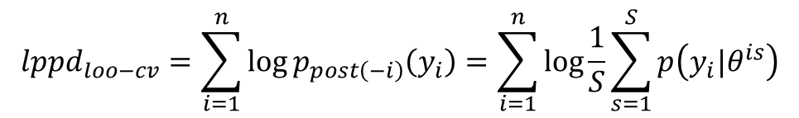
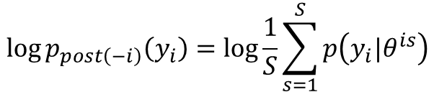

Leave-one-out cross-validation Bayesian LOO-CV
$y_{train}$：a training set
$$y_{1}$$
$$y_{2}$$
$$⋯$$
$$y_{i−1}$$
$$y_{i+1}$$
$$⋯$$
$$y_{n}$$
$$θ^{is}\sim p\left(θ|y_{train}\right), s=1,…,S$$
$$\log{p_{post\left(−i\right)}\left(y_{i}\right)}=\log{\frac{1}{S}\sum_{s=1}^{S}{p\left(y_{i}|θ^{is}\right)}}$$
$y_{holdout}$：
$$y_{i}$$
$${lppd}_{loo−cv}=\sum_{i=1}^{n}{\log{p_{post\left(−i\right)}\left(y_{i}\right)}}=\sum_{i=1}^{n}{\log{\frac{1}{S}\sum_{s=1}^{S}{p\left(y_{i}|θ^{is}\right)}}}$$
$$p_{loo−cv}=lppd−{lppd}_{loo−cv}$$

Slide 17
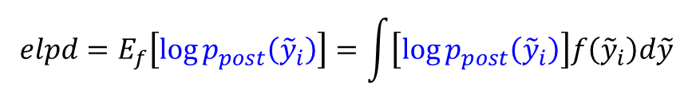
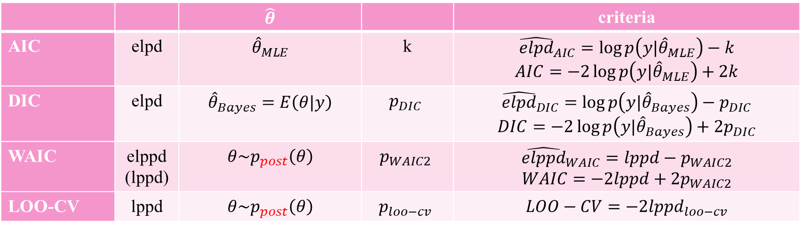
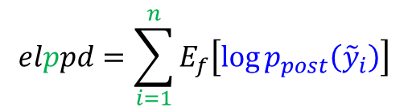
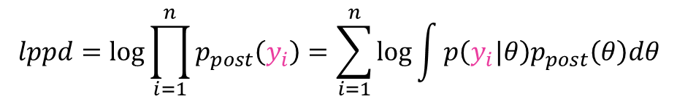
$$elpd=E_{f}\left[\log{p_{post}\left({\tilde{y}}_{i}\right)}\right]=\int{\left[\log{p_{post}\left({\tilde{y}}_{i}\right)}\right]f\left({\tilde{y}}_{i}\right)d\tilde{y}}$$
$$elppd=\sum_{i=1}^{n}{E_{f}\left[\log{p_{post}\left({\tilde{y}}_{i}\right)}\right]}$$
$$lppd=\log{\prod_{i=1}^{n}{p_{post}\left(y_{i}\right)}}=\sum_{i=1}^{n}{\log{\int{p\left(y_{i}|θ\right)p_{post}\left(θ\right)dθ}}}$$
 |  | $$\hat{θ}$$ |  | criteria
AIC | elpd | $${\hat{θ}}_{MLE}$$ | k | $${\hat{elpd}}_{AIC}=\log{p\left(y|{\hat{θ}}_{MLE}\right)}−k$$ $$AIC=−2\log{p\left(y|{\hat{θ}}_{MLE}\right)}+2k$$
DIC | elpd | $${\hat{θ}}_{Bayes}=E\left(θ|y\right)$$ | $$p_{DIC}$$ | $${\hat{elpd}}_{DIC}=\log{p\left(y|{\hat{θ}}_{Bayes}\right)}−p_{DIC}$$ $$DIC=−2\log{p\left(y|{\hat{θ}}_{Bayes}\right)}+2p_{DIC}$$
WAIC | elppd (lppd) | $$θ\sim p_{post}\left(θ\right)$$ | $$p_{WAIC2}$$ | $${\hat{elppd}}_{WAIC}=lppd−p_{WAIC2}$$ $$WAIC=−2lppd+2p_{WAIC2}$$
LOO-CV | lppd | $$θ\sim p_{post}\left(θ\right)$$ | $$p_{loo−cv}$$ | $$LOO−CV=−2{lppd}_{loo−cv}$$

Slide 18
x
y
越南戰爭
朝鮮戰爭
$$y\sim N\left(a+bx,σ^{2}\right)$$

Slide 19
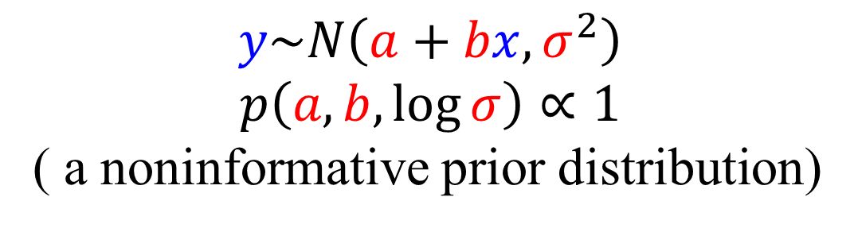
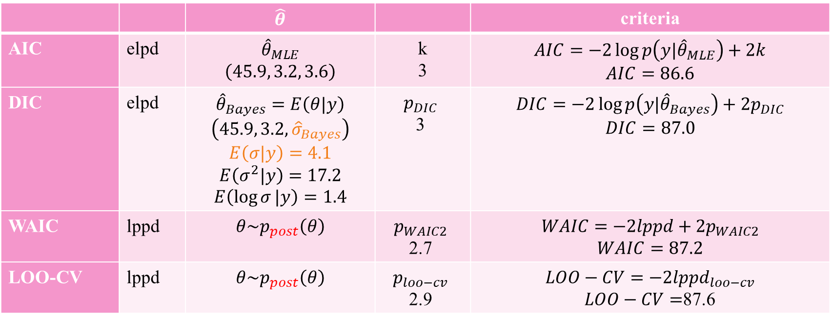
$$y\sim N\left(a+bx,σ^{2}\right)$$
$$p\left(a,b,\log{σ}\right)∝1$$
( a noninformative prior distribution)
 |  | $$\hat{θ}$$ |  | criteria
AIC | elpd | $${\hat{θ}}_{MLE}$$ $$\left(45.9, 3.2, 3.6\right)$$ | k 3 | $$AIC=−2\log{p\left(y|{\hat{θ}}_{MLE}\right)}+2k$$ $$AIC=86.6$$
DIC | elpd | $${\hat{θ}}_{Bayes}=E\left(θ|y\right)$$ $$\left(45.9, 3.2,{\hat{σ}}_{Bayes}\right)$$ $$E\left(σ|y\right)=4.1$$ $$E\left(σ^{2}|y\right)=17.2$$ $$E\left(\log{σ}|y\right)=1.4$$ | $$p_{DIC}$$ 3 | $$DIC=−2\log{p\left(y|{\hat{θ}}_{Bayes}\right)}+2p_{DIC}$$ $$DIC=87.0$$
WAIC | lppd | $$θ\sim p_{post}\left(θ\right)$$ | $$p_{WAIC2}$$ 2.7 | $$WAIC=−2lppd+2p_{WAIC2}$$ $$WAIC=87.2$$
LOO-CV | lppd | $$θ\sim p_{post}\left(θ\right)$$ | $$p_{loo−cv}$$ 2.9 | $$LOO−CV=−2{lppd}_{loo−cv}$$ $LOO−CV=$87.6

Slide 20

Model comparison based on predictive performance Example: Parallel experiments in eight schools

Slide 21
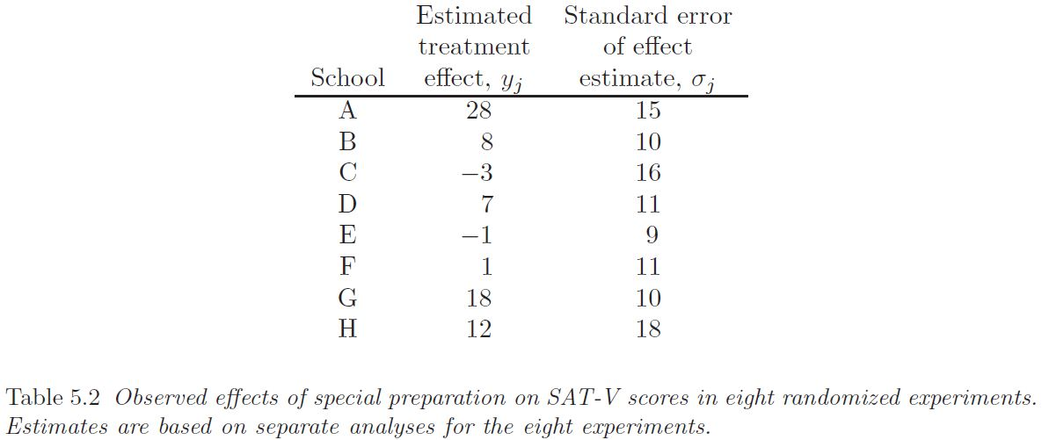
Model comparison based on predictive performance Expected predictive accuracy of models for the eight schools
Separate Model
Complete pooling Model
Hierarchical Model

Slide 22

















Parallel experiments in eight schools
$$N\left(μ,τ^{2}\right)$$
School 1
School 2
School 3
School 4
School 5
School 6
School 7
School 8
$$N\left(θ_{1},σ_{1}^{2} \right)$$
$$N\left(θ_{2},σ_{2}^{2} \right)$$
$$N\left(θ_{3},σ_{3}^{2} \right)$$
$$N\left(θ_{4},σ_{4}^{2} \right)$$
$$N\left(θ_{5},σ_{5}^{2} \right)$$
$$N\left(θ_{6},σ_{6}^{2} \right)$$
$$N\left(θ_{7},σ_{7}^{2} \right)$$
$$N\left(θ_{8},σ_{8}^{2} \right)$$
$$y_{1}$$
$$y_{2}$$
$$y_{3}$$
$$y_{4}$$
$$y_{5}$$
$$y_{6}$$
$$y_{7}$$
$$y_{8}$$

Slide 23

Parallel experiments in eight schools
Separate Model (no-pooling)
$$N\left(μ,τ^{2}\right)$$
$$τ=∞$$
School 1
School 2
School 3
School 4
School 5
School 6
School 7
School 8
$$N\left(θ_{1},σ_{1}^{2} \right)$$
$$N\left(θ_{2},σ_{2}^{2} \right)$$
$$N\left(θ_{3},σ_{3}^{2} \right)$$
$$N\left(θ_{4},σ_{4}^{2} \right)$$
$$N\left(θ_{5},σ_{5}^{2} \right)$$
$$N\left(θ_{6},σ_{6}^{2} \right)$$
$$N\left(θ_{7},σ_{7}^{2} \right)$$
$$N\left(θ_{8},σ_{8}^{2} \right)$$
$$y_{1}$$
$$y_{2}$$
$$y_{3}$$
$$y_{4}$$
$$y_{5}$$
$$y_{6}$$
$$y_{7}$$
$$y_{8}$$

Slide 24


Parallel experiments in eight schools
Complete pooling Model
$$N\left(μ,τ^{2}\right)$$
$$τ=0$$
School 1
School 2
School 3
School 4
School 5
School 6
School 7
School 8
$$N\left(θ_{1},σ_{1}^{2} \right)$$
$$N\left(θ_{2},σ_{2}^{2} \right)$$
$$N\left(θ_{3},σ_{3}^{2} \right)$$
$$N\left(θ_{4},σ_{4}^{2} \right)$$
$$N\left(θ_{5},σ_{5}^{2} \right)$$
$$N\left(θ_{6},σ_{6}^{2} \right)$$
$$N\left(θ_{7},σ_{7}^{2} \right)$$
$$N\left(θ_{8},σ_{8}^{2} \right)$$
$$y_{1}$$
$$y_{2}$$
$$y_{3}$$
$$y_{4}$$
$$y_{5}$$
$$y_{6}$$
$$y_{7}$$
$$y_{8}$$
$$θ_{1}=θ_{2}=⋯=θ_{8}=θ=μ$$

Slide 25
Parallel experiments in eight schools
Hierarchical Model
$$N\left(μ,τ^{2}\right)$$
School 1
School 2
School 3
School 4
School 5
School 6
School 7
School 8
$$N\left(θ_{1},σ_{1}^{2} \right)$$
$$N\left(θ_{2},σ_{2}^{2} \right)$$
$$N\left(θ_{3},σ_{3}^{2} \right)$$
$$N\left(θ_{4},σ_{4}^{2} \right)$$
$$N\left(θ_{5},σ_{5}^{2} \right)$$
$$N\left(θ_{6},σ_{6}^{2} \right)$$
$$N\left(θ_{7},σ_{7}^{2} \right)$$
$$N\left(θ_{8},σ_{8}^{2} \right)$$
$$y_{1}$$
$$y_{2}$$
$$y_{3}$$
$$y_{4}$$
$$y_{5}$$
$$y_{6}$$
$$y_{7}$$
$$y_{8}$$

Slide 26
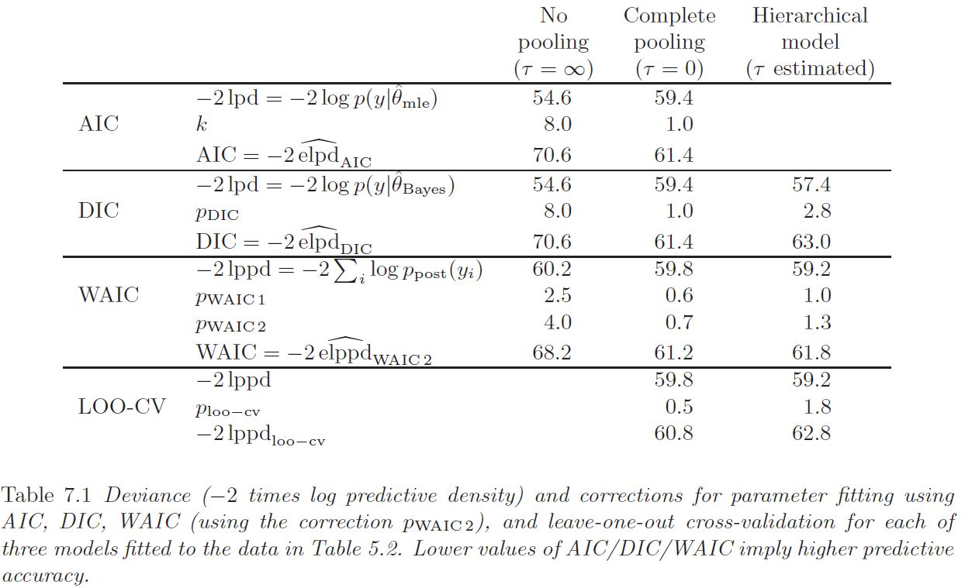
Model comparison based on predictive performance Expected predictive accuracy of models for the eight schools

Slide 27

Model comparison using Bayes factors

Slide 28
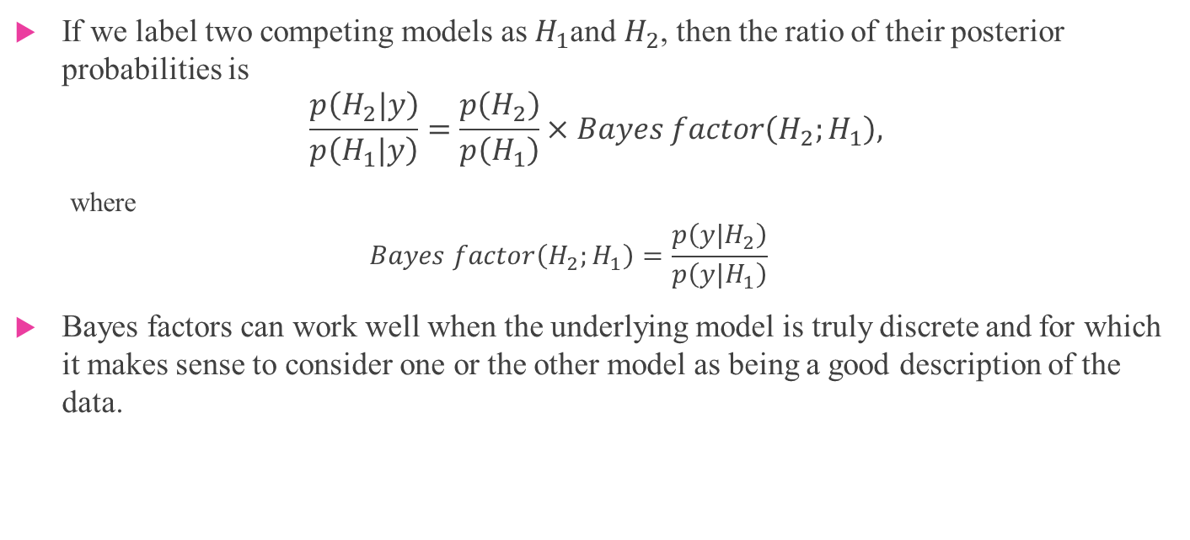
Bayes factors
If we label two competing models as $H_{1}$and $H_{2}$, then the ratio of their posterior probabilities is
$$\frac{p\left(H_{2}|y\right)}{p\left(H_{1}|y\right)}=\frac{p\left(H_{2}\right)}{p\left(H_{1}\right)}×Bayes factor\left(H_{2};H_{1}\right),$$
where
$$Bayes factor\left(H_{2};H_{1}\right)=\frac{p\left(y|H_{2}\right)}{p\left(y|H_{1}\right)}$$
Bayes factors can work well when the underlying model is truly discrete and for which it makes sense to consider one or the other model as being a good description of the data.

Slide 29
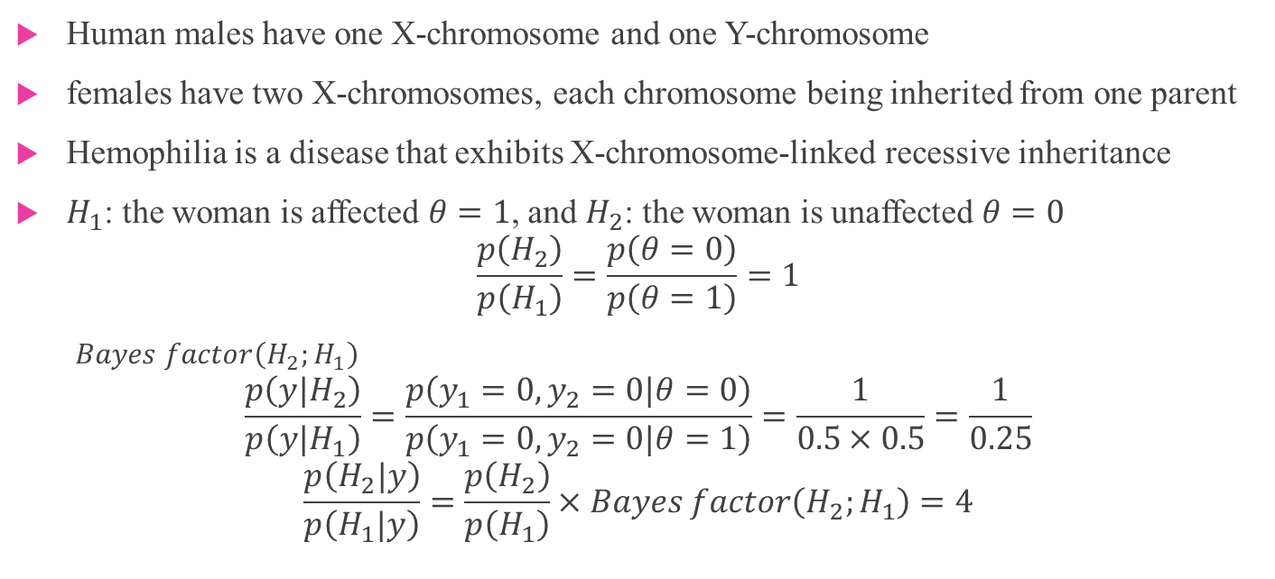
Bayes factors can work Hemophilia
Human males have one X-chromosome and one Y-chromosome
females have two X-chromosomes, each chromosome being inherited from one parent
Hemophilia is a disease that exhibits X-chromosome-linked recessive inheritance
$H_{1}$: the woman is affected $θ=1$, and $H_{2}$: the woman is unaffected $θ=0$
$$\frac{p\left(H_{2}\right)}{p\left(H_{1}\right)}=\frac{p\left(θ=0\right)}{p\left(θ=1\right)}=1$$
$Bayes factor\left(H_{2};H_{1}\right)$
$$\frac{p\left(y|H_{2}\right)}{p\left(y|H_{1}\right)}=\frac{p\left(y_{1}=0,y_{2}=0|θ=0\right)}{p\left(y_{1}=0,y_{2}=0|θ=1\right)}=\frac{1}{0.5×0.5}=\frac{1}{0.25}$$
$$\frac{p\left(H_{2}|y\right)}{p\left(H_{1}|y\right)}=\frac{p\left(H_{2}\right)}{p\left(H_{1}\right)}×Bayes factor\left(H_{2};H_{1}\right)=4$$

Slide 30
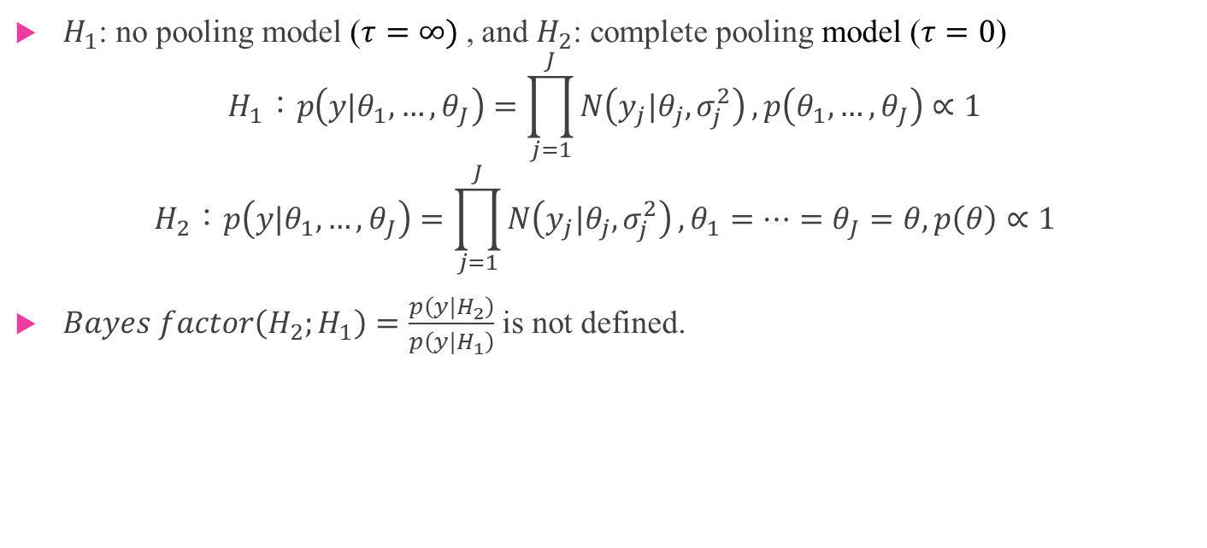
Bayes factors can NOT work Parallel experiments in eight schools
$H_{1}$: no pooling model ($τ=∞)$ , and $H_{2}$: complete pooling model ($τ=0$)
$$H_{1}：p\left(y|θ_{1},…, θ_{J}\right)=\prod_{j=1}^{J}{N\left(y_{j}|θ_{j},σ_{j}^{2}\right)}, p\left(θ_{1},…, θ_{J}\right)∝1$$
$$H_{2}：p\left(y|θ_{1},…, θ_{J}\right)=\prod_{j=1}^{J}{N\left(y_{j}|θ_{j},σ_{j}^{2}\right)},θ_{1}=…=θ_{J}=θ,p\left(θ\right)∝1$$
$Bayes factor\left(H_{2};H_{1}\right)=\frac{p\left(y|H_{2}\right)}{p\left(y|H_{1}\right)}$ is not defined.

Slide 31
Continuous model expansion

Slide 32
Continuous model expansion
Sensitivity analysis
To fit several probability models to the same problem
Adding parameters to a model
If the model does not fit the data
If a modeling assumption is questionable or has no real justification
If two different models are under consideration, they can be combined into a larger model using a continuous parameterization that includes the original models as special cases.
A model can be expanded to include new data
Accounting for model choice in data analysis
Selection of predictors and combining information
Alternative model formulations
Practical advice for model checking and expansion
for both model checking and sensitivity analysis

Slide 33

The End

